Slide 1
Java 4 WEB
Lesson 11 – Reflection API, Annotations

Slide 2
Lesson goals
JVM and Memory
java.lang.reflect
java.lang.annotation
java.time
Internationalization/Localization

Slide 3
JVM and Memory

Slide 4
JVM Structure
*.class
CLASS LOADER
Runtime Data Area
Heap Memory
Non-heap Memory
Java Stack
GC
Native method stack
Native Libs
*.dll
Execution Engine
Native Interface
Notes:
Java Heap space is used by java runtime to allocate memory to Objects and JRE classes. Whenever we create any object, it’s always created in the Heap space.
Java Stack memory is used for execution of a thread. They contain method specific values that are short-lived and references to other objects in the heap that are getting referred from the method.

Slide 5
ClassLoader
Internet
File
DB
ClassLoader
JVM
public Class<?> loadClass(String name)
public static ClassLoader getSystemClassLoader()
public InputStream getResourceAsStream(String name)
protected Class<?> findClass(String name)
Notes:
Class loaders are responsible for loading Java classes during runtime dynamically to the JVM

Slide 6
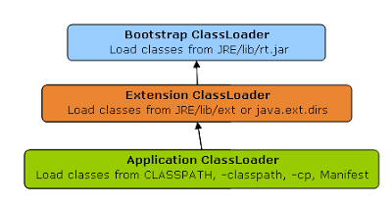
ClassLoader hierarchy

Slide 7
Native Methods
JNI (Java Native Interface) - standard mechanism for running code that is written in C / C ++ or Assembler languages, and is assembled as dynamic libraries
Java Application
JNI
//native method call
public native int nativeMethod();
DLL

Slide 8
Reflection API

Slide 9
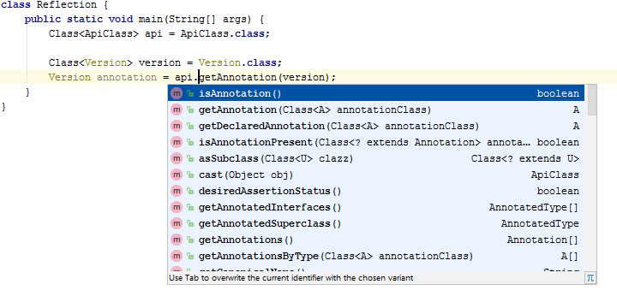
Reflection
The ability to examine or modify the runtime behavior of applications
- read properties
- update data
- change model
- …
Notes:
Uses of Reflection
Extensibility Features
Class Browsers and Visual Development Environments
Debuggers, frameworks and Test Tools

Slide 10
java.lang.Class
get the metadata of a class at run time
examine and change the run time behavior of a class

Slide 11
Class obtaining
forName() method of Class class
Class userClass = Class.forName(“org.geekhub.lesson11.User");
getClass() method of Object class
Class userClass = userInstance.getClass();
the .class syntax
Class userClass = User.class
By classloader

Slide 12
Class instantiation
try {
Class<User> userClass = User.class; User user = userClass.newInstance(); //requires no-args constructor log(user.getName()); } catch (InstantiationException | IllegalAccessException e) { log("Can not instantiate user by reflection: {}“, e.getMessage()); }

Slide 13
Class instantiation
try { Class[] argumentsTypes = {int.class, String.class, int.class, String.class}; Constructor<User> constructor = userClass.getConstructor(argumentsTypes); User user = constructor.newInstance(1, "Johny", 78, "UTF"); log(user); //User{id=1, name='Johny', favoriteEncoding='UTF', accessLevel=78} } catch (Exception e) { log("Error: {}", e.getMessage()); }

Slide 14
Declared fields
Class<User> userClass = User.class; Field declaredFields[] = userClass.getDeclaredFields(); for (Field field : declaredFields) { log("\t" + field); }
private static final long org.geekhub.lesson11.User.serialVersionUID
public int org.geekhub.lesson11.User.id
public java.lang.String geek.User.name
public int org.geekhub.lesson11.User.accessLevel
public java.lang.String org.geekhub.lesson11.User.favoriteEncoding

Slide 15
Methods
Class<User> userClass = User.class; Method methods[] = userClass.getMethods(); for (Method method : methods) { log("\t" + method); }
public java.lang.String org.geekhub.lesson11.User.toString()
public java.lang.String org.geekhub.lesson11.User.getName()
public int org.geekhub.lesson11.User.getId()
public int org.geekhub.lesson11.User.getAccessLevel()
public java.lang.String org.geekhub.lesson11.User.getFavoriteEncoding()
public final void java.lang.Object.wait() throws java.lang.InterruptedException
…
public final native void java.lang.Object.notify()
public final native void java.lang.Object.notifyAll()

Slide 16
Declared methods
Class<User> userClass = User.class; Method declaredMethods[] = userClass.getDeclaredMethods(); for (Method method : declaredMethods) { log("\t" + method); }
public java.lang.String org.geekhub.lesson11.User.toString()
public java.lang.String org.geekhub.lesson11.User.getName()
public int org.geekhub.lesson11.User.getId()
private void org.geekhub.lesson11.User.setName(java.lang.String)
private void org.geekhub.lesson11.User.setId(int)
public int org.geekhub.lesson11.User.getAccessLevel()
private void org.geekhub.lesson11.User.setAccessLevel(int)
public java.lang.String org.geekhub.lesson11.User.getFavoriteEncoding()
private void org.geekhub.lesson11.User.setFavoriteEncoding(java.lang.String)

Slide 17
Non visible model
1. public Method getDeclared*(…)throws … 2. public void setAccessible(
boolean status
) throws SecurityException 3. public Object invoke(
Object method,
Object ... args
) throws IllegalAccessException, IllegalArgumentException, InvocationTargetException
Notes:
setAccessible(boolean status - sets the accessibility of unit.
Invoke is used to invoke the method.

Slide 18
Invisible method invocation
Class<User> userClass = User.class; User user = new User(1, "John", 20, "UTF");
log(user.name); // John try { Method setter = userClass.getDeclaredMethod("setName", String.class); nameSetter.setAccessible(true); nameSetter.invoke(user, "Roberto"); log(user.name); // Roberto } catch (NoSuchMethodException | IllegalAccessException | InvocationTargetException e) { log("Error: {}“, e.getMessage()); }

Slide 19
Invisible field update
Class<User> userClass = User.class; User user = new User(1, "John", 20, "UTF"); log(user.name); // John try { Field nameField = userClass.getDeclaredField("name"); nameField.setAccessible(true); nameField.set(user, "Roberto"); log(user.name); // Roberto } catch (NoSuchFieldException | IllegalAccessException e) { log("Error: {}“, e.getMessage()); }

Slide 20
Annotations
Notes:
Annotation - form of metadata, providing data about a program that is not part of the program itself.
Information for the compiler — to detect errors or suppress warnings.
Compile-time and deployment-time processing — code generation, work with XML files, and so forth.
Runtime processing — Some annotations are available to be examined at runtime.

Slide 21
Annotations
@Deprecated
@Override
@SuppressWarnings
@FunctionalInterface
@NonNull
…

Slide 22
Annotations - RetentionPolicy
RetentionPolicy | Description
SOURCE | Annotations are to be discarded by the compiler.
CLASS | Annotations are to be recorded in the class file by the compiler but need not be retained by the VM at run time. This is the default behavior.
RUNTIME | Annotations are to be recorded in the class file by the compiler and retained by the VM at run time, so they may be read reflectively.

Slide 23
Annotations - TargetElementType
ElementType | Description
TYPE | Class, interface (including annotation type), or enum declaration
FIELD | Field declaration (includes enum constants)
METHOD | Method declaration
PARAMETER | Formal parameter declaration
CONSTRUCTOR | Constructor declaration
LOCAL_VARIABLE | Local variable declaration
ANNOTATION_TYPE | Annotation type declaration
PACKAGE | Package declaration
TYPE_PARAMETER | Type parameter declaration
TYPE_USE | Use of a type

Slide 24
Annotations. Is something not OK?
@Target(value = ElementType.METHOD) @Retention(value = RetentionPolicy.RUNTIME) @Documented @Inherited public @interface Version { int min(); int max(); String description() default ""; }
class ApiClass { @Version void api0(){}
@Deprecated @Version(min = 1, max = 2) void api1(){} @Version(min = 2, max = 3,
description = "Api with JSON support") void api2(){} } @Version class ApiClass2 {}

Slide 25
Annotations. Something not OK.
@Target(value = ElementType.METHOD) @Retention(value = RetentionPolicy.RUNTIME) @Documented @Inherited public @interface Version { int min(); int max(); String description() default ""; }
class ApiClass { @Version // required attributes are missed void api0(){}
@Deprecated @Version(min = 1, max = 2) void api1(){} @Version(min = 2, max = 3,
description = "Api with JSON support") void api2(){} } @Version // wrong target element type class ApiClass2 {}

Slide 26
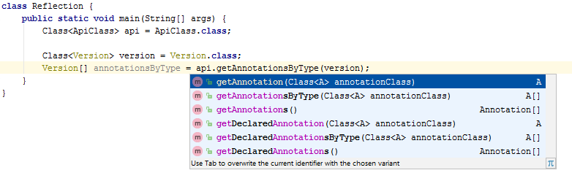
Class annotations usage

Slide 27
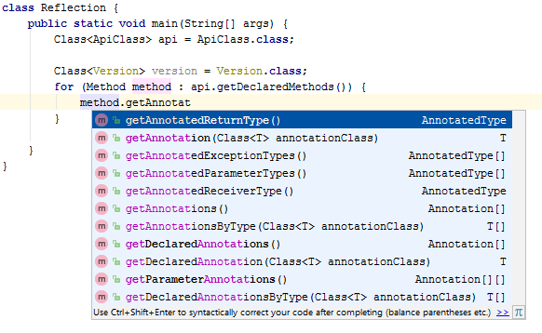
Method annotations usage

Slide 28
Annotations access
Class<ApiClass> apiClass = ApiClass.class; Class<Version> annotationClass = Version.class; for (Method method : apiClass.getDeclaredMethods()) { if(method.isAnnotationPresent(Version.class)){ log(method + " supports version"); } log(method + " has next annotations"); for (Annotation annotation : method.getAnnotations()) { log("\t" + annotation); } }
void org.geekhub.lesson11.ApiClass.api1() supports version
void org.geekhub.lesson11.ApiClass.api1() has next annotations
@java.lang.Deprecated()
@org.geekhub.lesson11.Version(description=, min=1, max=2)
void org.geekhub.lesson11.ApiClass.api2() supports version
void org.geekhub.lesson11.ApiClass.api2() has next annotations
@org.geekhub.lesson11.Version(description=Api with JSON support, min=2, max=3)

Slide 29
Date/Time API

Slide 30
Date and time
Instant - a point in time from the epoch of 1970-01-01Z in the UTC zone time.
LocalDate - just a date (no time and no time zone). (birthday this year)
LocalTime - just a time (no date and no time zone). (midnight)
LocalDateTime - both a date and time (no time zone). (the stroke of midnight on New Year’s Eve)
ZonedDateTime Contains a date, time, and time zone. (a conference call at 6:00 p.m. EEST - If you live in Seattle, you’ll have to get up really early since the call is at 9:00 a.m. local time!)

Slide 31
Timezone
ZoneId zone = ZoneId.of("US/Eastern");
ZonedDateTime zoned1 = ZonedDateTime.of(2015, 1, 20, 6, 15, 30, 200, zone);
ZonedDateTime zoned2 = ZonedDateTime.of(date1, time1, zone);
ZonedDateTime zoned3 = ZonedDateTime.of(dateTime1, zone);

Slide 32
Period
public static void main(String[] args) { LocalDate start = LocalDate.of(2015, Month.JANUARY, 1); LocalDate end = LocalDate.of(2015, Month.MARCH, 30); Period period = Period.ofMonths(1); performEnrichment(start, end, period); }
private static void performEnrichment(
LocalDate start, LocalDate end, Period period
) { LocalDate upTo = start; while (upTo.isBefore(end)) { log("give new toy: {}”, upTo); upTo = upTo.plus(period); } }

Slide 33
Duration
public static void main(String[] args) { LocalDate start = LocalDate.of(2015, Month.JANUARY, 1); LocalDate end = LocalDate.of(2015, Month.MARCH, 30); Duration duration = Duration.ofDays(1); performEnrichment(start, end, duration); }
private static void performEnrichment(
LocalDate start, LocalDate end, Duration duration
) { LocalDate upTo = start; while (upTo.isBefore(end)) { log("give new toy: {}“, upTo); upTo = upTo.plus(duration); } }

Slide 34
Internationalization Localization

Slide 35
I18n and l10n
Internationalization (I18n) - process of designing your program so it can be adapted. This involves placing strings in a property file and using classes like DateFormat so that the right format is used based on user preferences. Precondition of localization.
Localization (l10n) – support of multiple locales. Translating strings to different languages, outputting dates and numbers in the correct format for that locale, currency, colors, legal specific.
Notes:
Locale - a specific geographical, political, or cultural region.

Slide 36
Resource Bundle
A resource bundle contains the local specific objects to be used by a program. It is like a map with keys and values. The resource bundle can be in a property file or in a Java class.
A property file is a file in a specific format with key/value pairs.

Slide 37
Resource Bundle
class ZooOpen { public static void main(String[] args) { Locale us = new Locale("en", "US"); Locale france = new Locale("fr", "FR"); printProperties(us); printProperties(france); }
public static void printProperties(Locale locale) { ResourceBundle rb = ResourceBundle.getBundle("Zoo", locale); log(rb.getString("hello")); log(rb.getString("open")); }
Zoo_en.properties
hello=Hello
open=The zoo is open.
Zoo_fr.properties
hello=Bonjour
open=Le zoo est ouvert

Slide 38
Literature
Reflection API
Using java reflection
Annotations
Memory model
Java classloaders

Slide 39
Homework Task 1
Implement CloneCreator interface(s). Program should do a deep clone (deep model, reference type fields should be considered as well, i.e. support tree structure). If inner object does not implements CanBeCloned interface (except built-in JDK classes), throw a custom checked exception CanNotCloneException. Implement (override) equals method and compare original and clone object. Add custom @Ignore annotation, if field annotated by this annotation – do not clone. Ignored fields also should not be compared. Cover by unit tests.
interface CloneCreator { <T extends CanBeCloned> T clone(T object) {throws clause if needed}; }

Slide 40
Homework Task 2
Implement ChangeSetExtractor interface. It should compare two objects with the same type (deep model, reference type fields should be copmared as well, i.e. support tree structure). Difference between two objects should be stored in instance of a ChangeSet class. ChangeSet should contain only changes, also be able to provide info about the old and the new value. Add custom @Ignore annotation, if field annotated by this annotation – do not include it into changeset. Cover by unit tests.
interface ChangeSetExtractor<T> { ChangeSet extract(T oldObject, T newObject); }

